Slide 1
ECEN 5283 Project 4: Image Segmentation by Clustering
Alexander Rose
Oklahoma State University
4/8/2024

Slide 2
Objective
This project is part of the lectures covering mid-level vision.
In this project, students learn two clustering techniques:
K-means clustering
EM algorithm for data clustering
These techniques are implemented on three images
Mosaic A
Mosaic B
A photo of a baboon from lecture (for color testing)

Slide 3
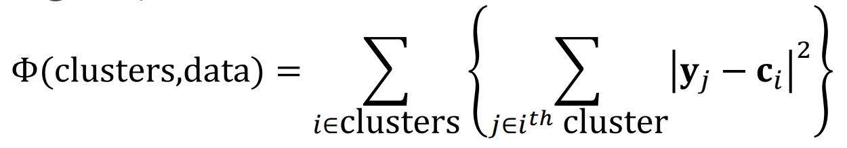
Technical Background – Kmeans
K-means algorithm is an algorithm that is useful for clustering isotropic data.
However, it is poor at clustering non-isotropic data
To evaluate how effective the K-means performed, we can implement intra-class divergence as our optimization function (lower divergence is better).
The K-means algorithm always converges since it adjusts the cluster center each time data points are evaluated. Once the data points remain unchanged, the center will remain unchanged, and the algorithm has converged.
One issue is that K-means can get stuck in local optimums rather than finding the global optimum.

Slide 4
Technical Background – EM

Slide 5
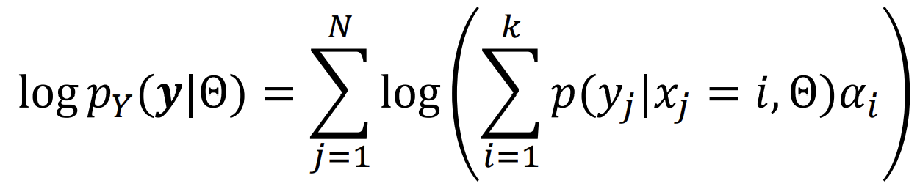
T.B. – Loglikelihood and Accuracy

Slide 6
Experimental Results

Slide 7
General process
I have a file called main.m which performs Gabor filtering on mosaicA.bmp and mosaicB.bmp with 4 scales and 4 orientations. These images are then smoothed via a 3x3 gaussian filter with matlab’s imgaussfilt function.
I create a set of feature vectors including x and y coordinates of the pixels. These feature vectors are column vectors with 18 components.
After normalization, the vectors are input to the K-means algorithm, and the algorithm is run 15 times to prevent the results from staying in a local optimum. The best and worst results are recorded.
Finally, in EM_main, I choose which set of data to run and the number of clusters. The results are recorded in a video.

Slide 8
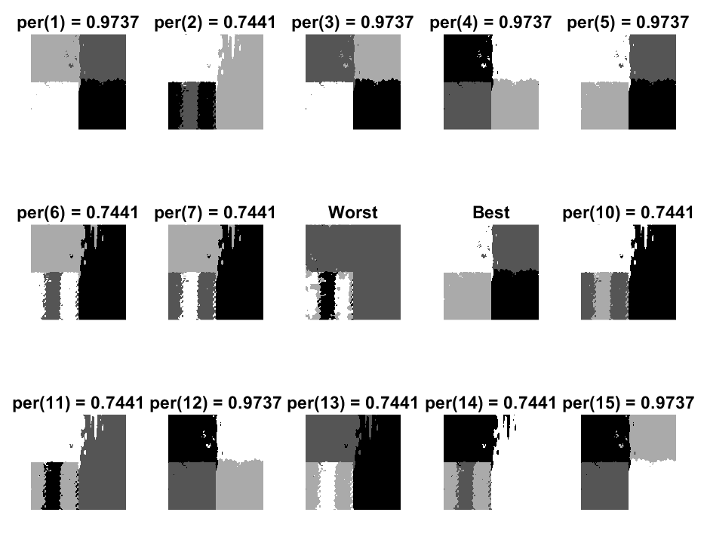
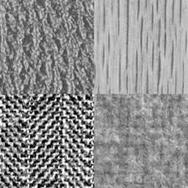
Mosaic A K-means results

Slide 9
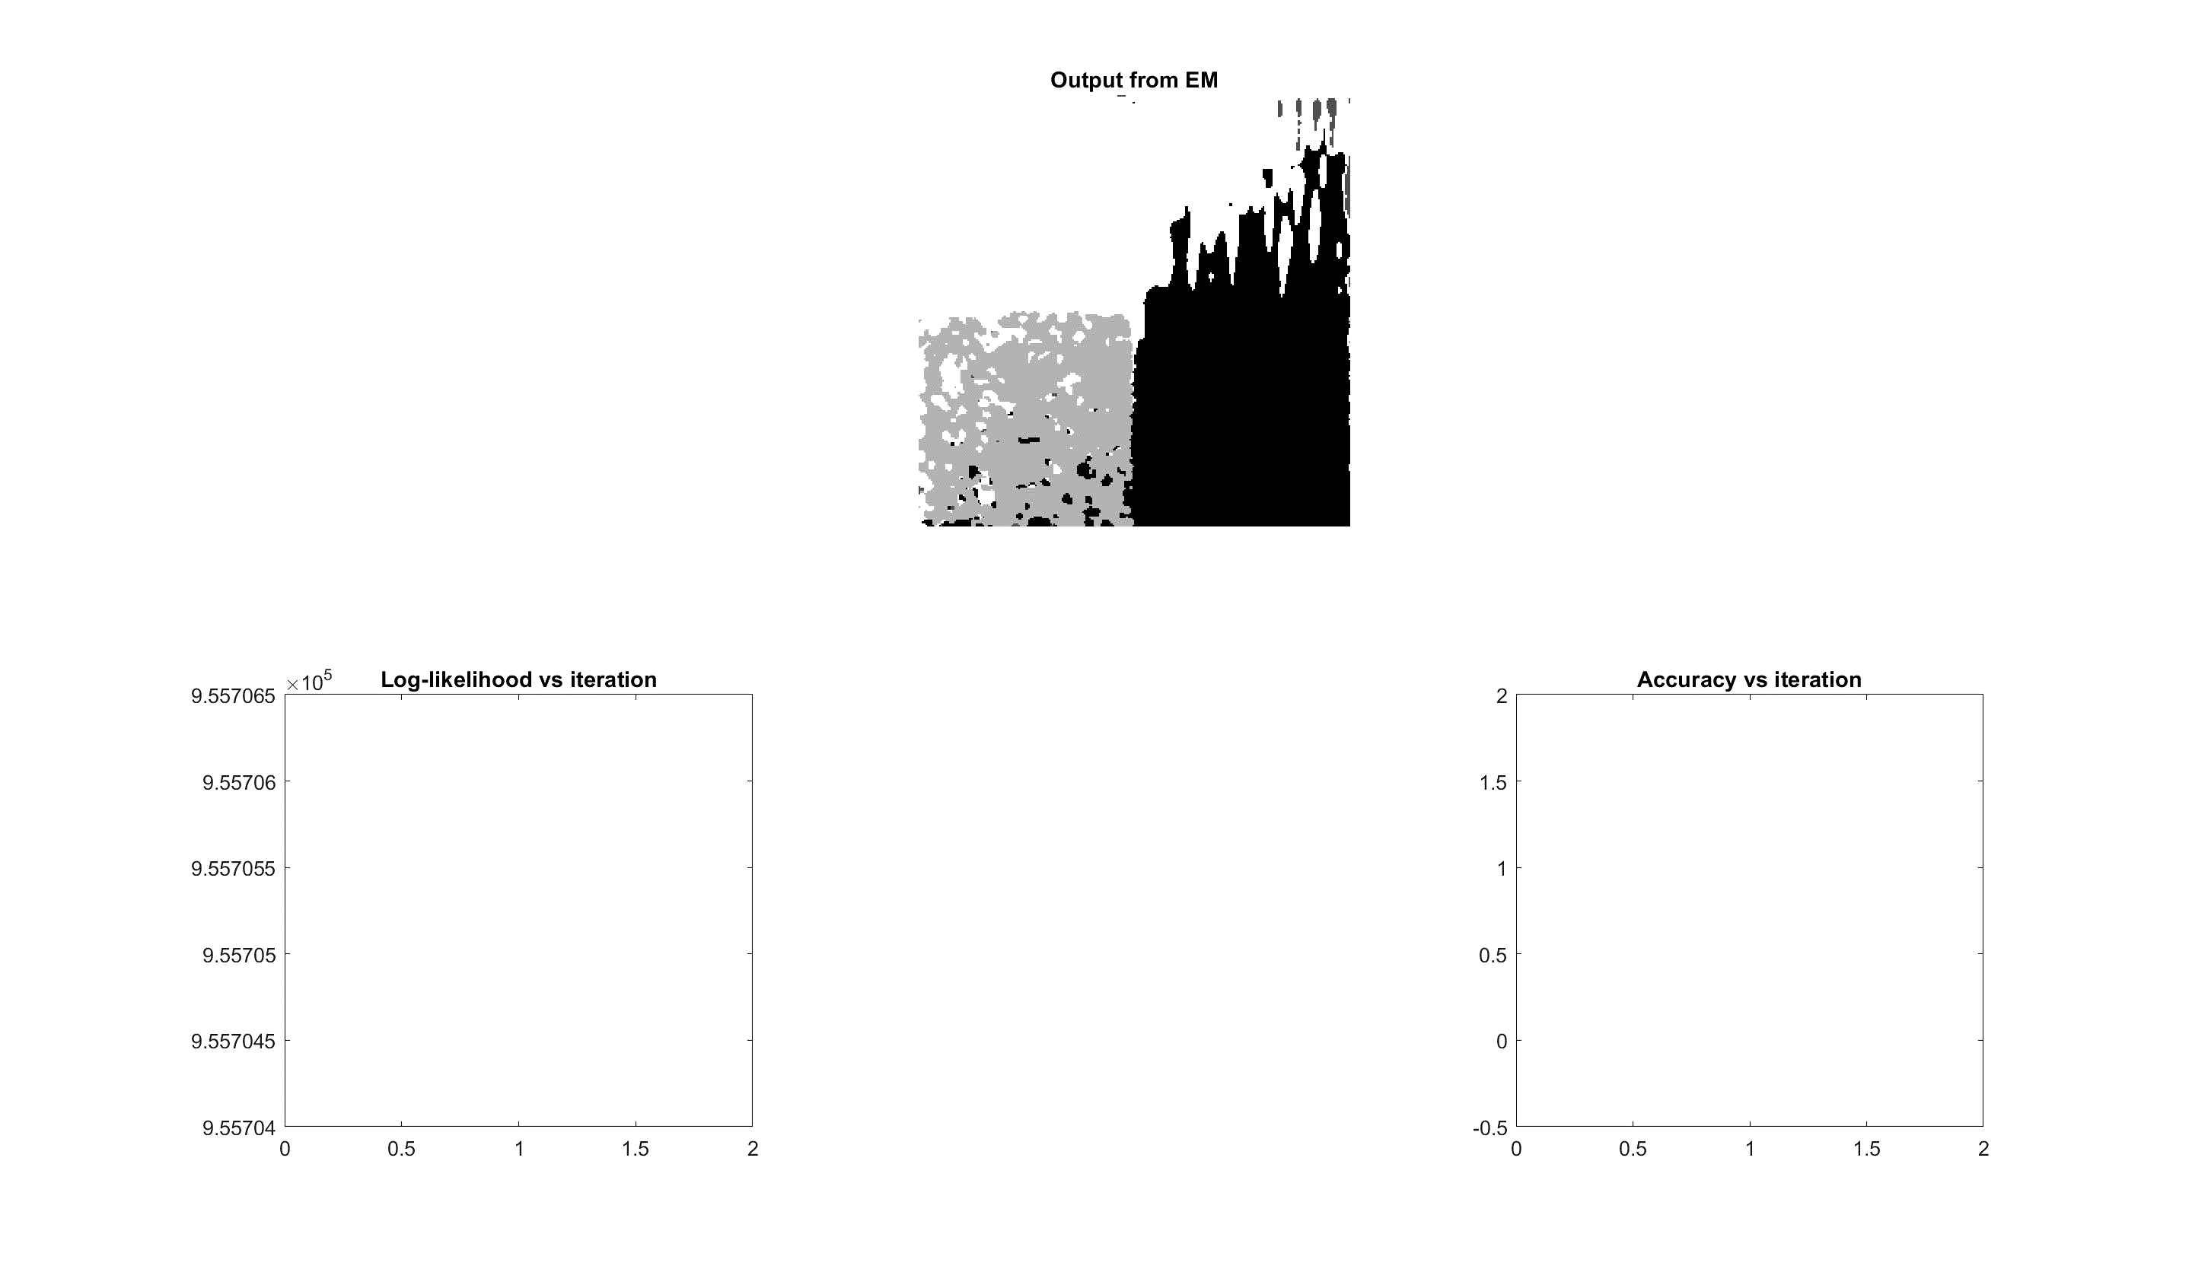
Mosaic A EM – Results on Best

Slide 10
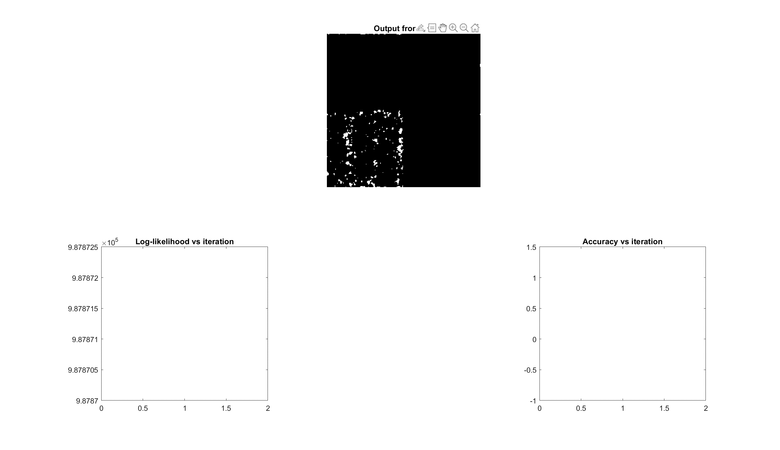
Mosaic A EM – Results on Worst

Slide 11
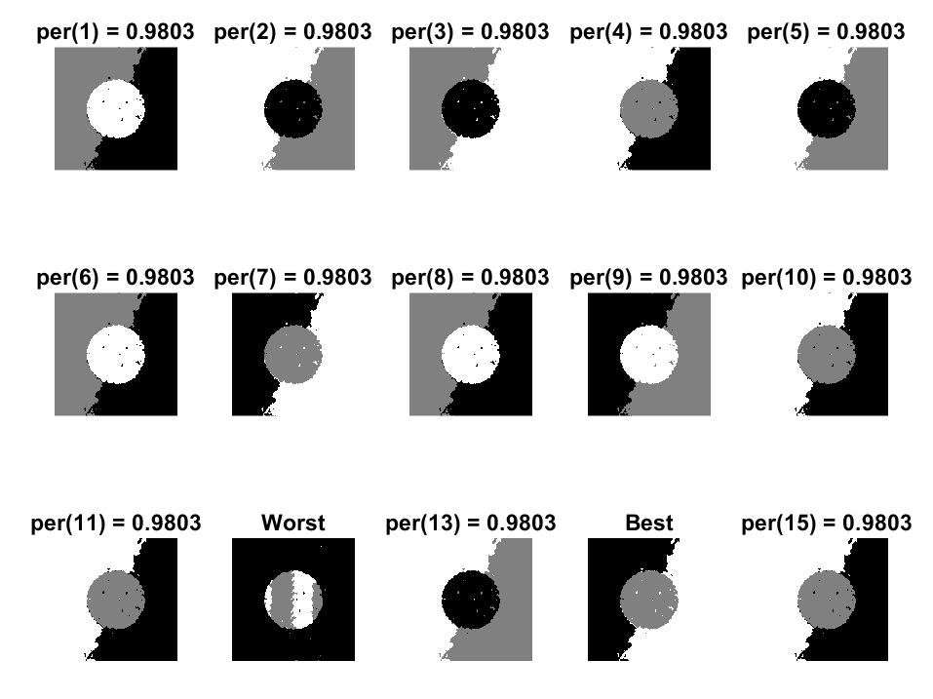
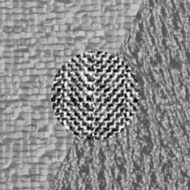
Mosaic B K-means results

Slide 12
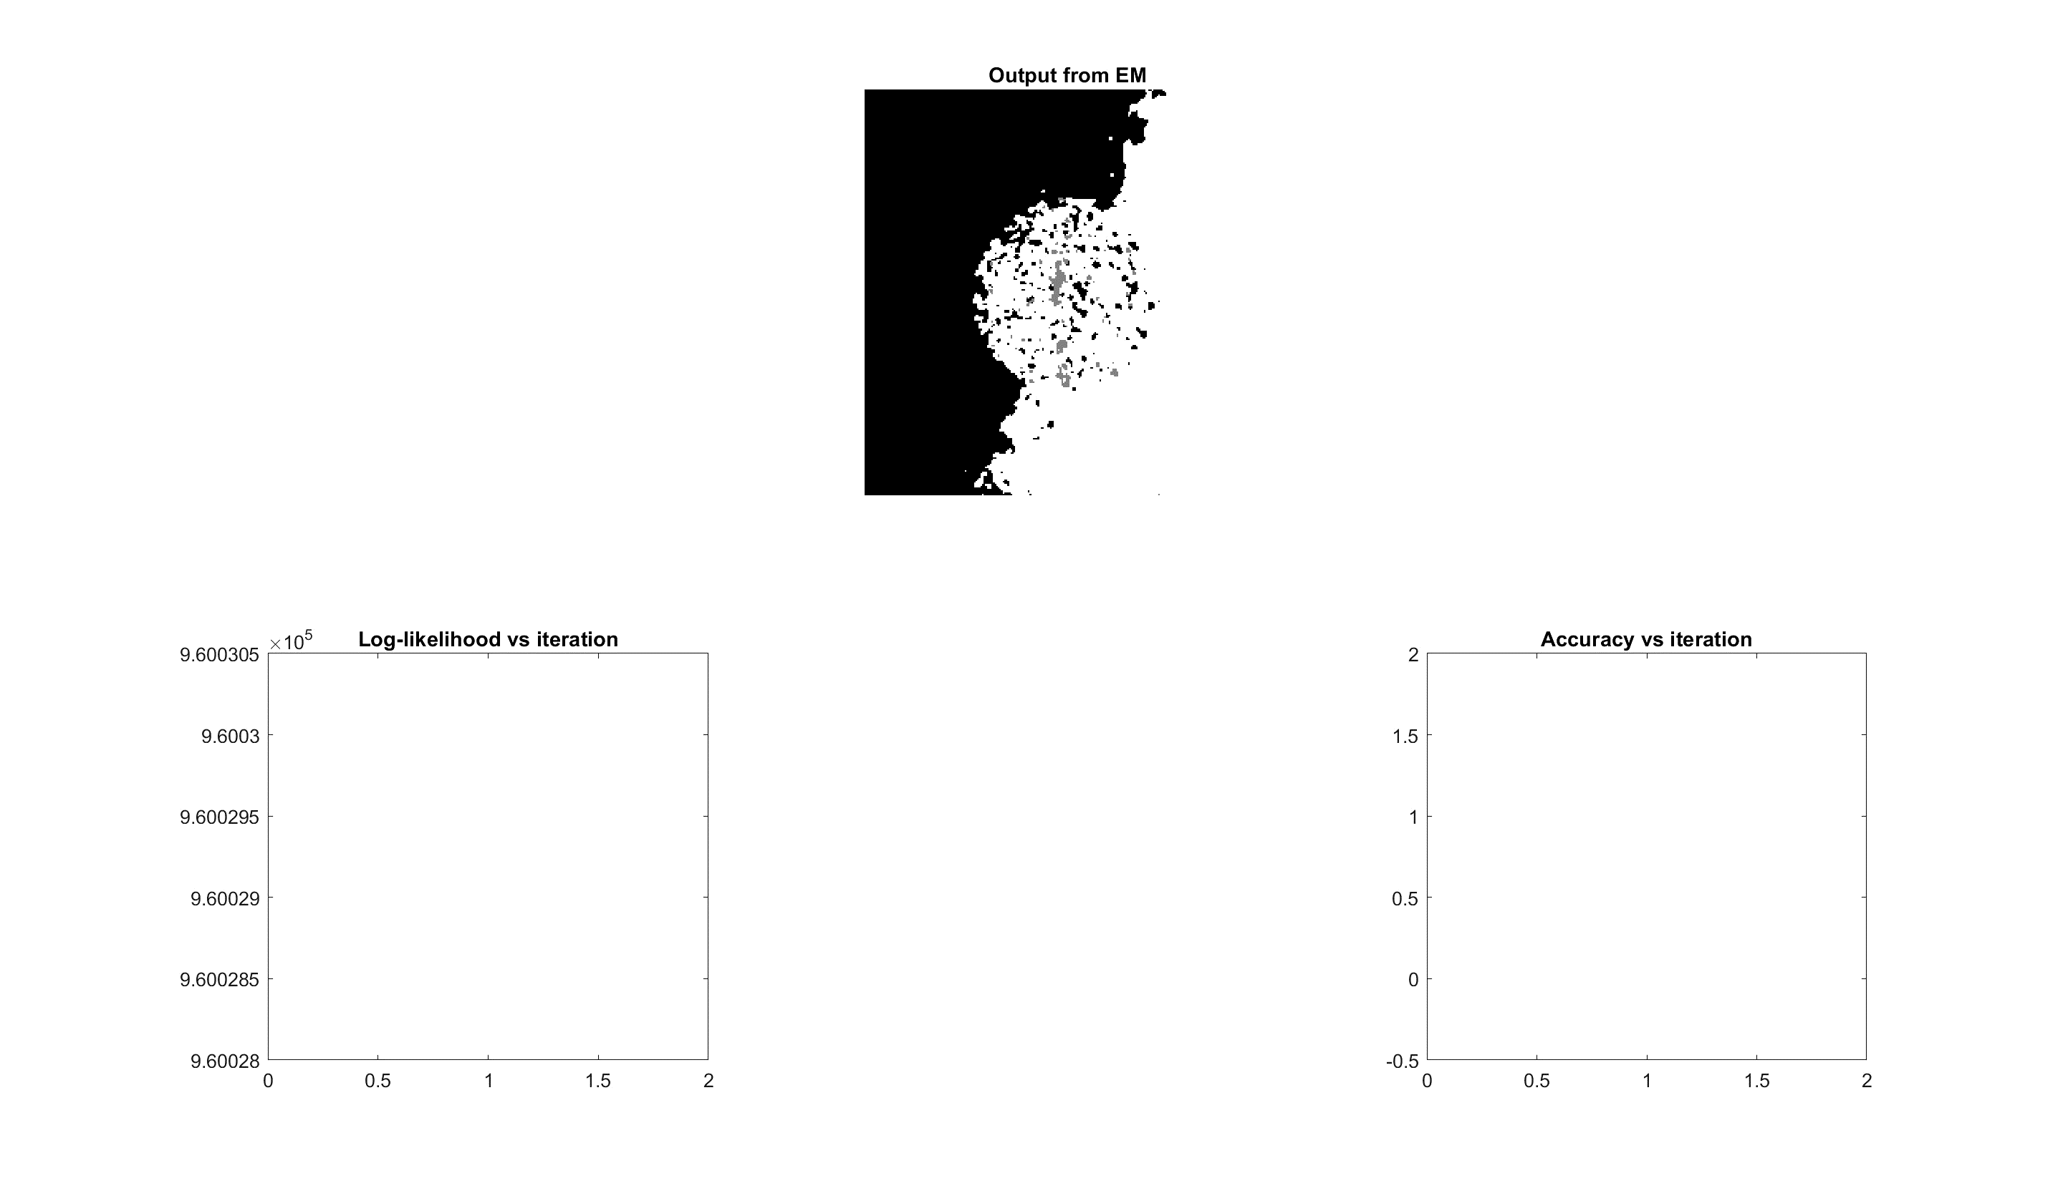
Mosaic A EM – Results on Best

Slide 13
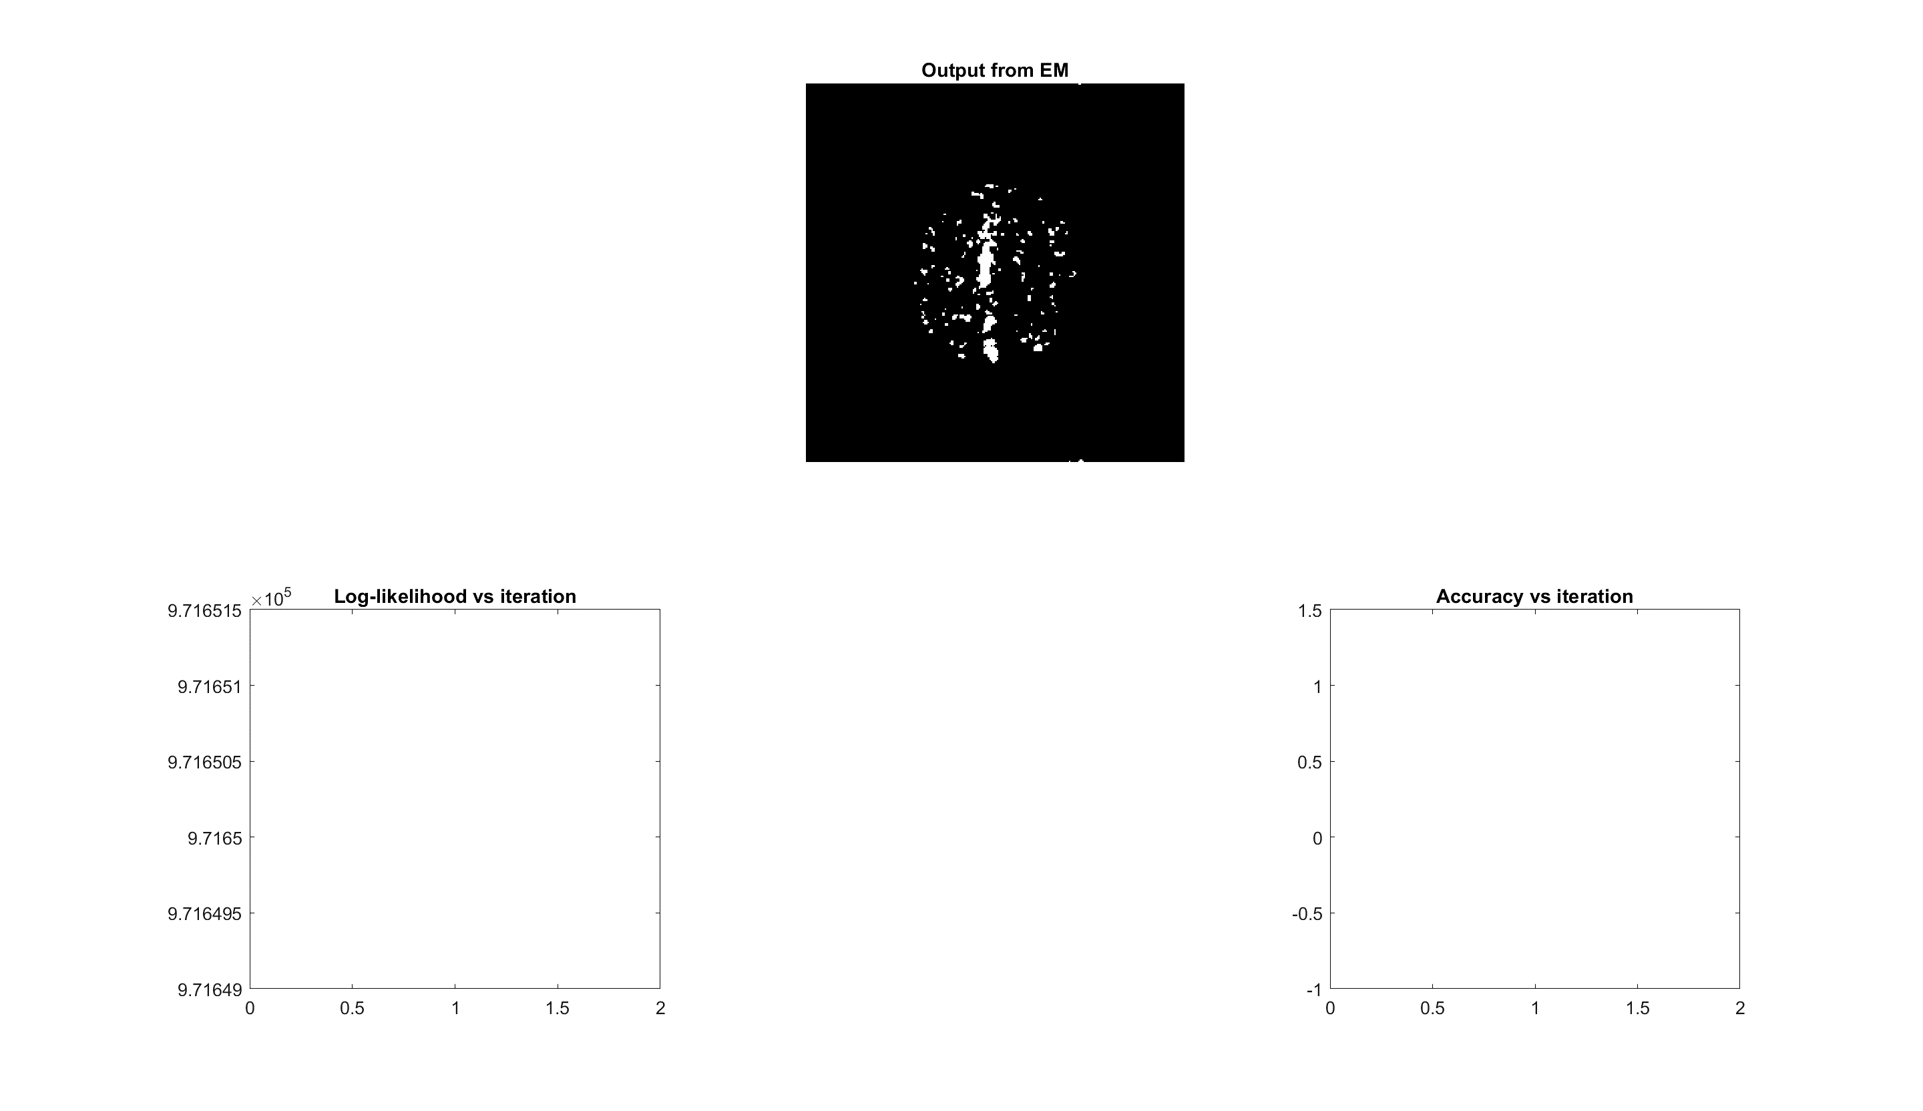
Mosaic B EM – Results on Worst

Slide 14
Discussion and Conclusion

Slide 15
Appendix – Code – Main file

